Slide 1
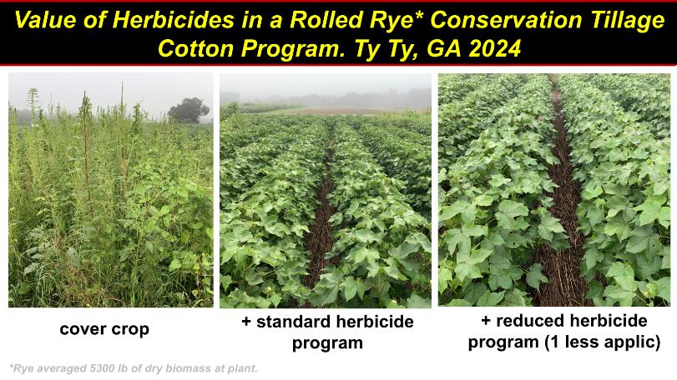
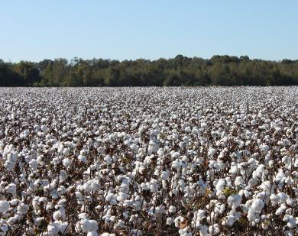
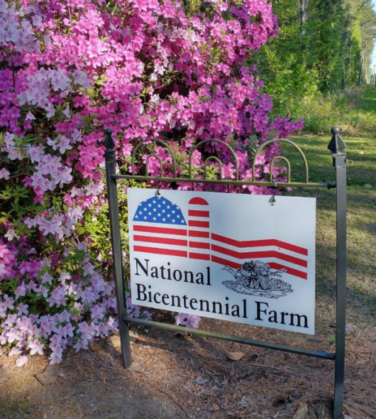
Cotton Weed Control Update – 2025
Stanley Culpepper
University of Georgia
Tifton GA
Herbicides….anything new?
Cotton weed management program
Preparing you for ESA compliance
1772
Woodland, NC

Slide 2
Dicamba: In-Crop 2025
Baring politics appears to be no chance for Engenia, Tavium, or XtendiMax for 2025 – ESA
Quite concerned about getting them for 2026
Section 18 has no chance
Section 24 c local need label…..????
UPW only if a label is successful

Slide 3
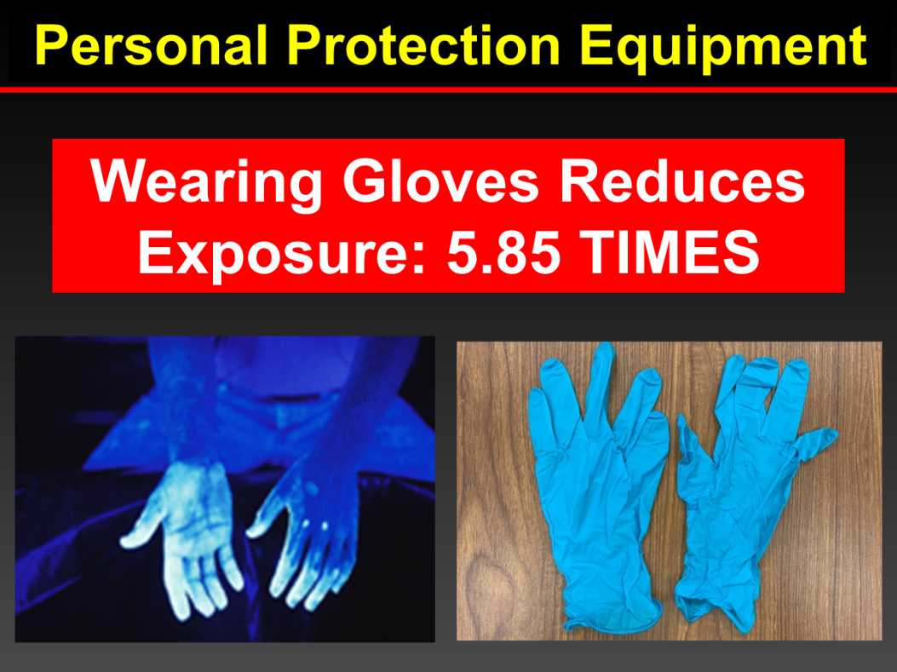
Diuron
Diuron
2025/2026 availability good
EPA/manufacturers working through risk assessment

Slide 4
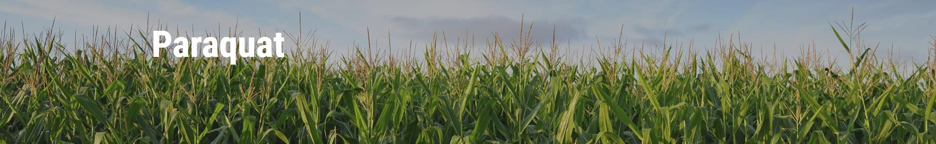
The paraquat training module is now live on Syngenta’s website. It is available at Paraquat Training. Links from Gramoxone 2.0 and 3.0 pages have been updated along with the EPA paraquat page.
No charge for the training
English and Spanish
One time registration form requiring name, email address, state, and pesticide application license number.
Automatic renewal email

Slide 5
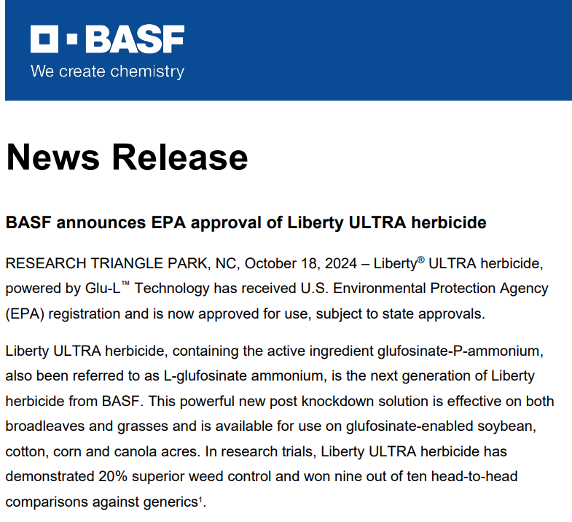
Liberty Ultra
Rate range 24-29 fl oz.
May make up to 2 applications in crop or one preplant + one in crop.
Emergence till early bloom
Liberty Ultra 24 oz ~= Liberty at 32-36 oz.
Do not exceed 58 oz for entire year

Slide 6
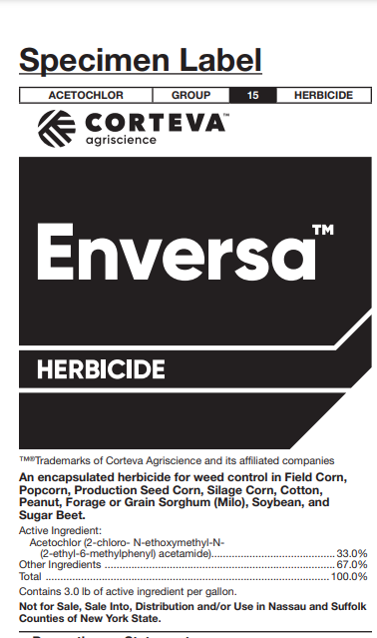
Enversa – Encapsulated Acetochlor for Cotton
PRE rate range: 1.25 to 2 quarts; optimum is 1.5 qt/A
POST 1.5 quarts: after cotton is completely emerged but before it reaches first bloom
Do not exceed 2 qt per application or 4 qts for year.
Research is seeing major differences from Warrant as influenced by “drying” time

Slide 7
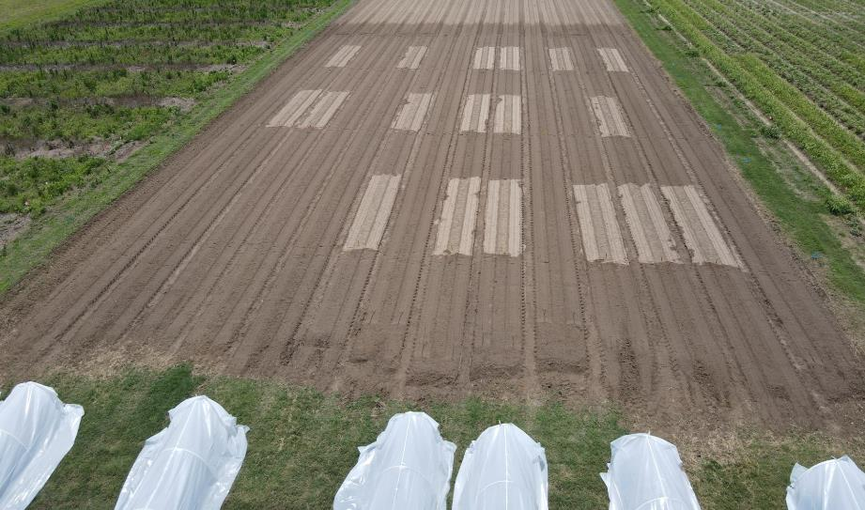
Palmer control with Enversa vs Warrant
Irrigation Day 0
Irrigation Day 2
94 a
99 a
76 b
90 b
Enversa
Warrant
Enversa
Warrant
Irrigation Day 7
99 a
94 a
Irrigation 0.4” on Day 0, 2, or 7
Enversa
Warrant
Rate for both products 48 oz/A; evaluation ~2 wk after irrigation

Slide 8
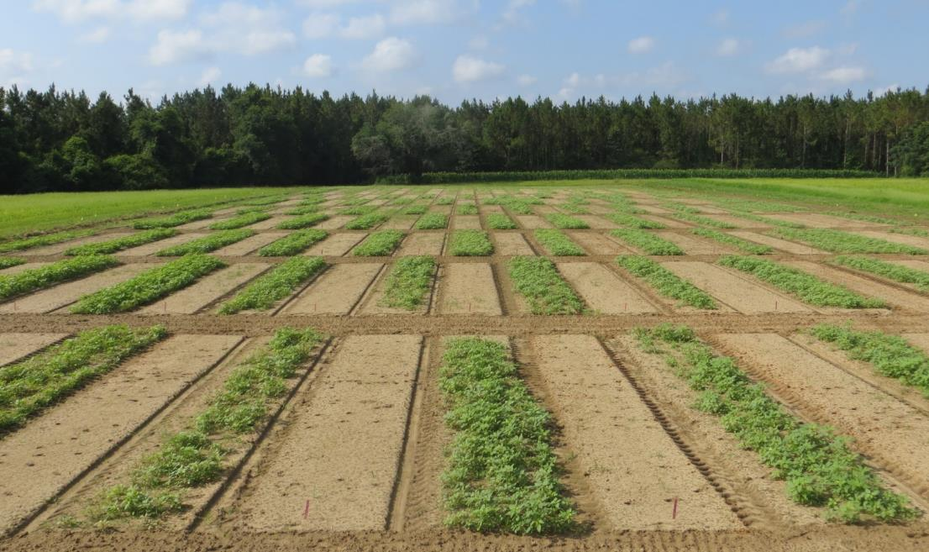
Alite 27….. Axant ISO Systems Are Strong!
Must plant tolerant cultivar (Stoneville)
Little to no crop response
Residual at 2.5 to 3 oz/A is very good
Tank-mix needed, very broad spectrum
Every other bed is treated with a tank mix partner with Axant

Slide 9
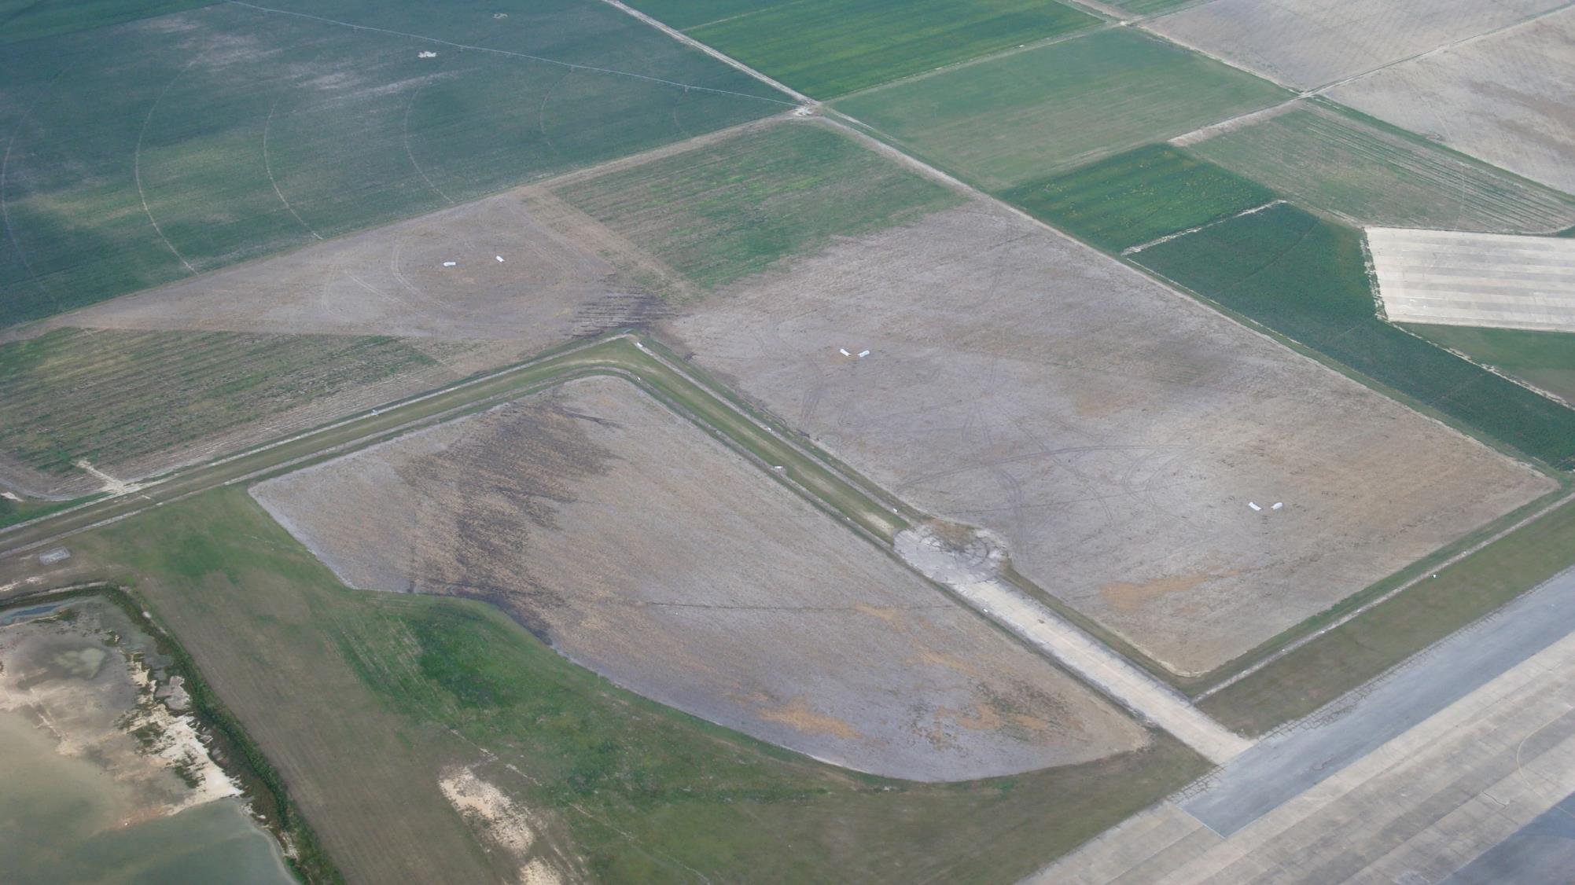
Comparing 2,4-D Formulations. #1 Drift Issue in 2024
Much Volatility Research in GA
Ester
Amine
Choline
N
NW
NE
W
E
SW
SE
Sunbelt Expo
S

Slide 10
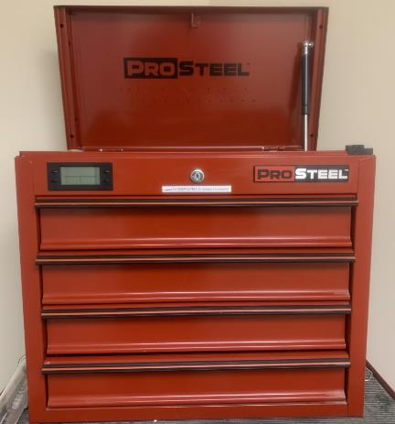
Greatest Threats to Weed Management
Availability of economically effective pesticides is essential
Three mighty challenges
Weed Control Toolbox
Weed Control Toolbox
Economics on the farm
Herbicide
resistance
Regulatory actions

Slide 11
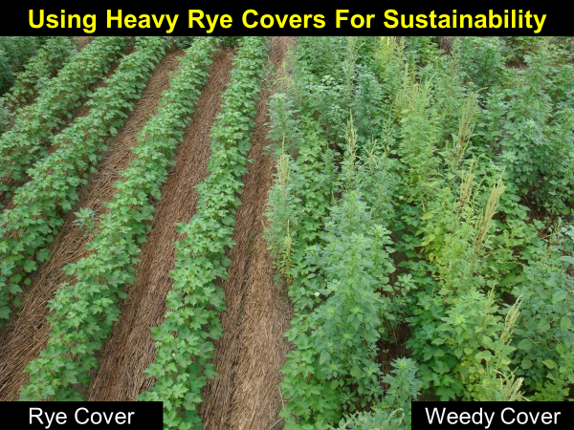
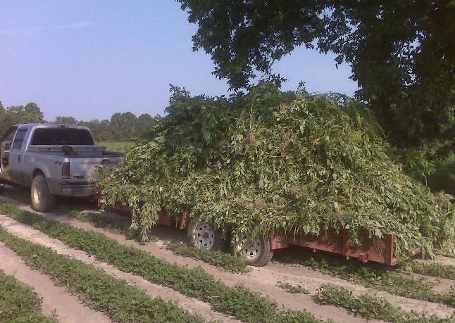
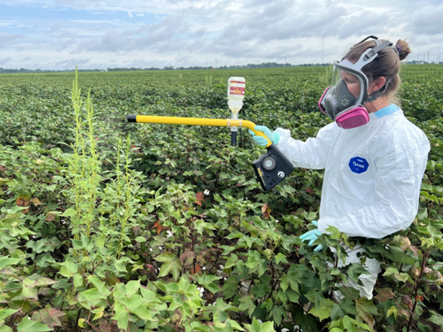
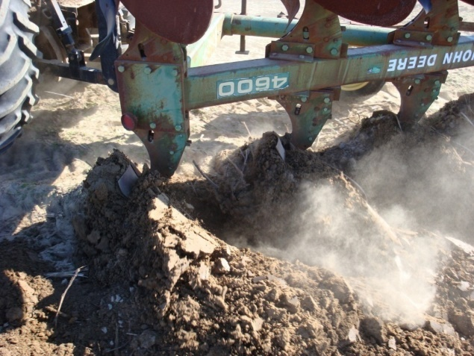
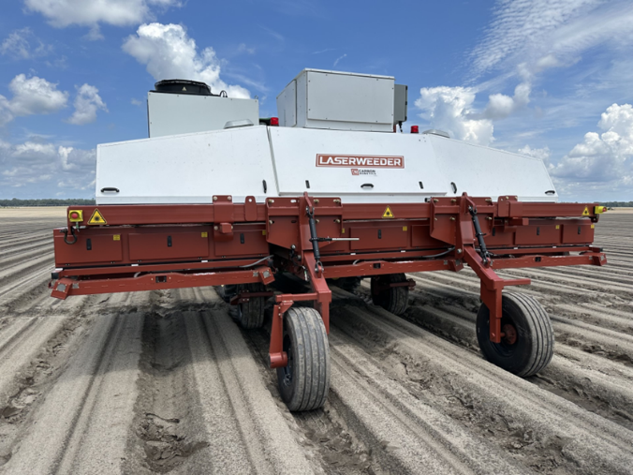
Step 1: Herbicides Alone Are Not Sustainable
Hand Weed - eliminate seed production
WeedOut pollen
Deep Tillage
Notes:
11

Slide 12
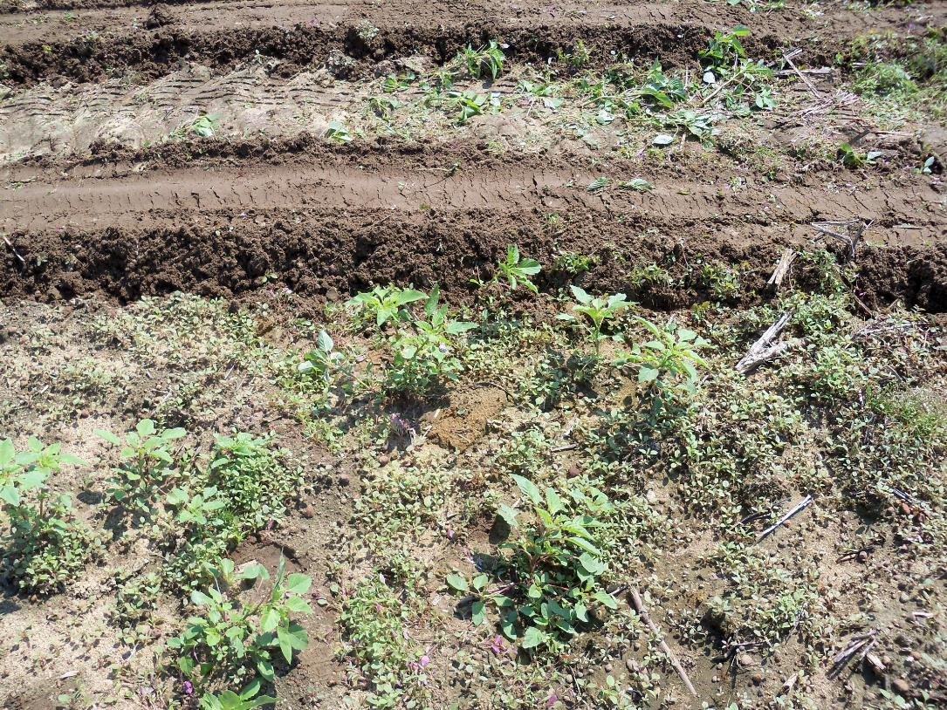
#2: Don’t plant into emerged pigweed
Planting operation covers plants with dirt …. herbicides won’t kill
Plant stressed from planters running…. herbicide often don’t kill
Less residual to the ground….residual herbicides are key
Stop and spray something like Gramoxone + Direx before running strip till rig and planting!

Slide 13
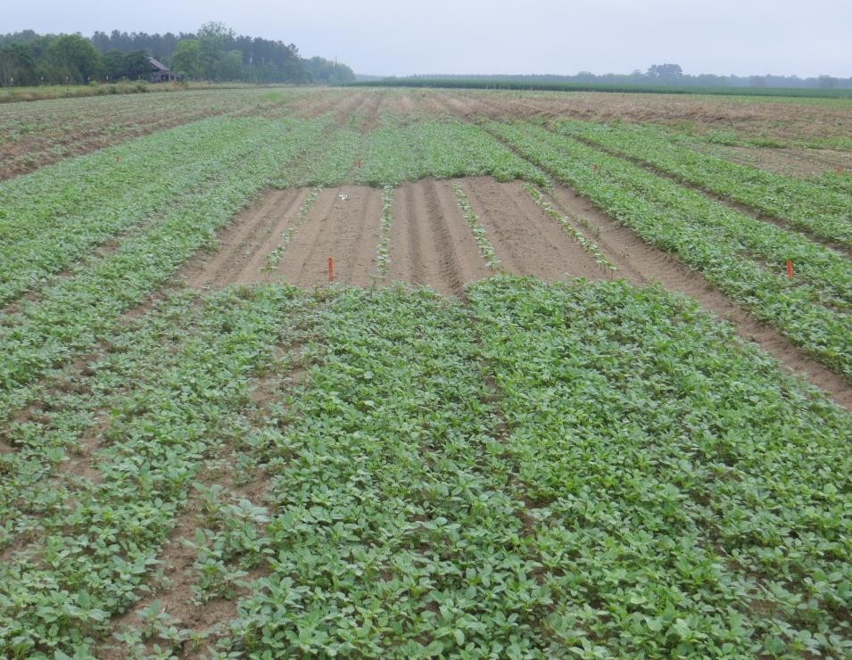
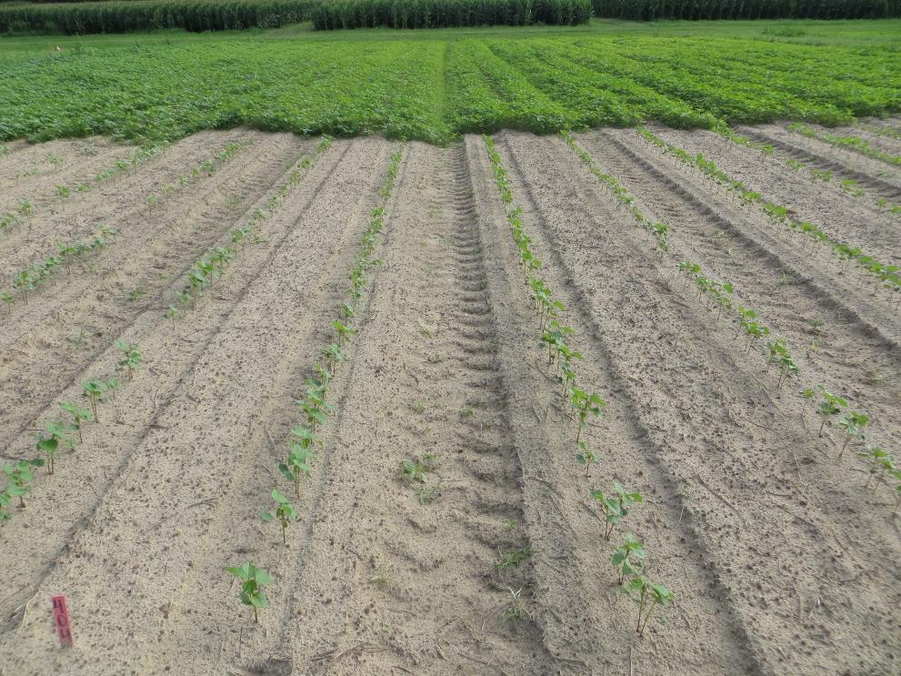
Step 3: At least two residuals effective on Palmer at plant!
Reduces selection pressure – POST Herbicides!!!!!
Improves coverage POST herbicides
Removes early-season competition -- often higher yield

Slide 14
Residual herbicide influences Palmer population at POST1
Number per acre at 14 days, 2024
2,156,220 a
All treatments 99% or better control
#/A
13612 b
7078 b
23413 b
7078 b
No PRE
Brake+ Reflex
Reflex +Warrant
Brake+ Alite
Reflex+ Direx+ Warrant
C19-2024; Brake 16 oz, Direx 1 pt, Reflex 12 oz, Warrant 2 pt, Alite 2.5 oz

Slide 15
Residual herbicide influences Palmer height at POST1
Height at 19 days, 2024
5.5 a
Inches
2.16 b
1.52 b
1.57 b
1.37 b
No PRE
Brake+ Reflex
Reflex +Warrant
Brake+ Alite
Reflex+ Direx+ Warrant
C19-2024; Brake 16 oz, Direx 1 pt, Reflex 12 oz, Warrant 2 pt, Alite 2.5 oz

Slide 16
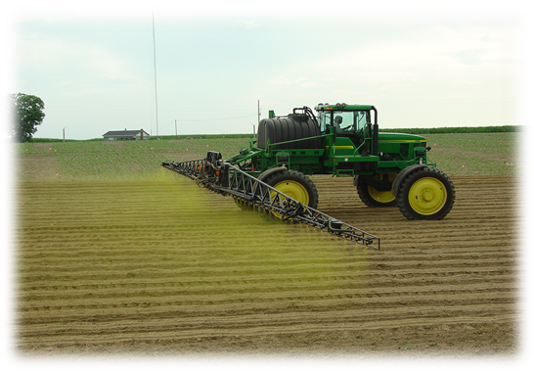
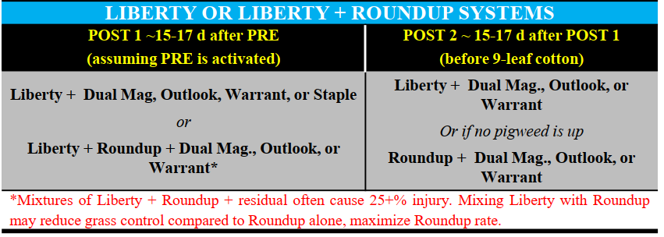
Step 4: Timely Postemergence Applications
Decisions made on weed size?
Decisions based on weed biology?
Concept of overlapping residual (key)
Avoid antagonism

Slide 17
Weed Response to Roundup, Liberty, and Mixtures.
% Large Crabgrass Control
100 a
86 b
53 c
100 a
% Goosegrass Control
Roundup
Liberty
Liberty+RU
100 a
78 b
53 c
Roundup
Liberty
Liberty+RU
% Pink Purslane Control
100 a
78 b
68 c
Roundup PMAX 3 = full rate; Liberty = full rate. Goosegrass 6”; purslane 15”, crabgrass 8”. Veg 5-2024.
Roundup
Liberty
Liberty+RU

Slide 18
Texas Millet Control by RU as Influenced by Dicamba
99 a
100 a
84 b
%
3” tall
10” tall
10” tall
RU PMAX 32 oz
+
XtendiMax 22 oz
RU PMAX
32 oz
RU PMAX 32 oz
+
XtendiMax 22 oz

Slide 19
Limiting antagonism from POST tank mixtures
Smaller weed sizes, usually less than few inches
Residual herbicides reducing density and size
Full herbicide rates
Coverage essential
Sequential applications may make you money, especially with goosegrass

Slide 20
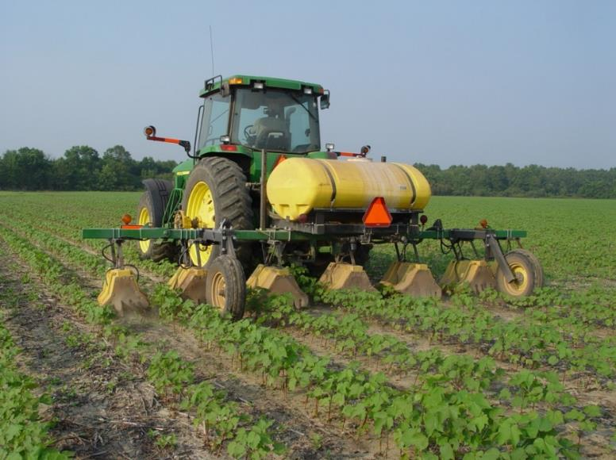
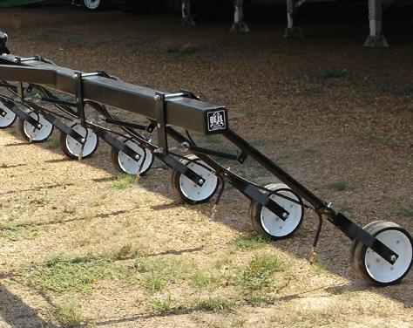
Layby is a GAME CHANGER for weed control!!!
RU + Direx + Envoke
Direx + MSMA + Envoke

Slide 21
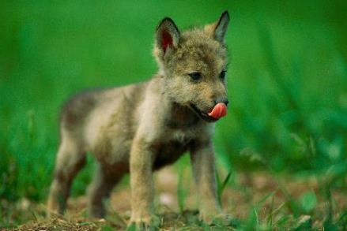
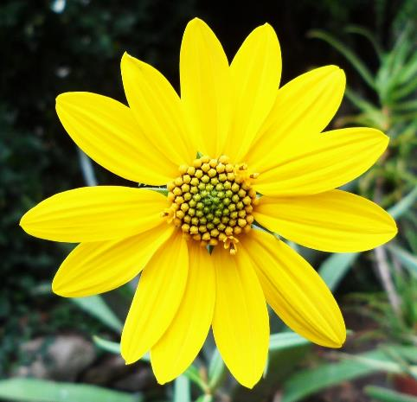
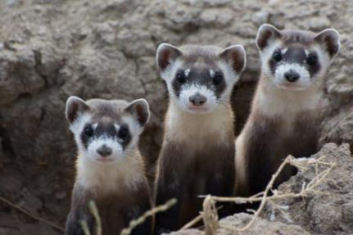
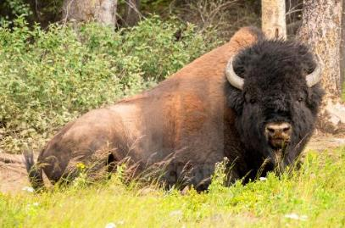
The Endangered Species Act (ESA)
ESA implemented in 1973
Provides framework to conserve & protect endangered & threatened species & their habitats!
Grey Wolf
Whorled Sunflower
Black-footed Ferret
Total of ~1600 species + 900 critical habitats!!!
Wood Bison

Slide 22

The Dilemma with ESA
Court removal of tools
Overwhelming regulations

Slide 23
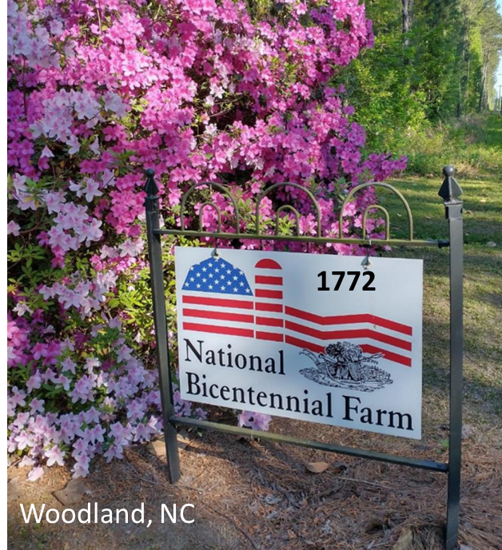
We Have Time and Can Simplify for Farmers
Advisors
Extension
Consultants
Retailers
Manufacturers
Department of Agriculture

Slide 24
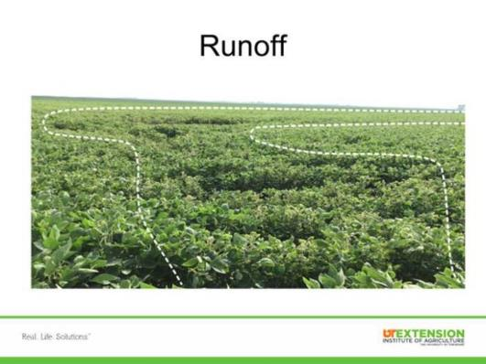
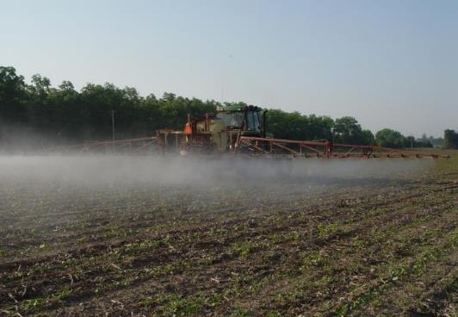
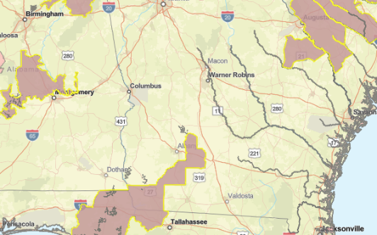
#1
Must Understand To Get Started
1. Runoff: each pesticide will be assigned a value of potential of product to runoff and damage species or habitat (0-9 points).
2. Particle Drift: each pesticide will be given a buffer drift requirement as influenced by application method (ground, airblast, airplane, etc.)
3. BLT: Website identifies if your field is in a pesticide use limitation area (PULA).
#2
Particle drift
#3
Bulletins Live! Two

Slide 25
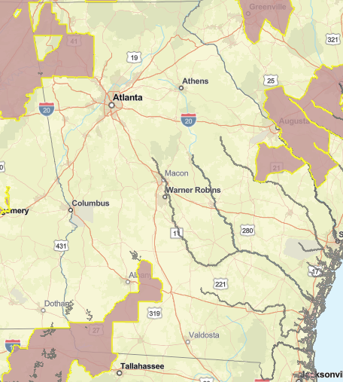

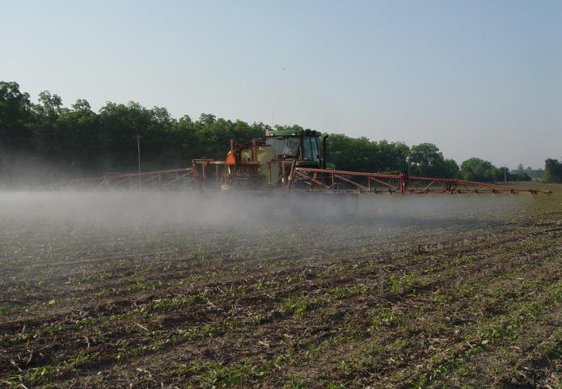
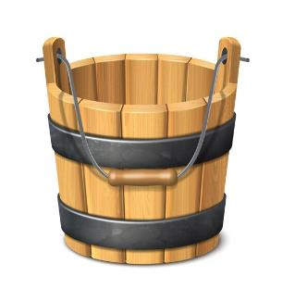
It is Very Complicated, Lets Do it Together
#3
#1
#2
BLT!
Particle drift
0-9 points
0-230 feet
Pesticide Use Limitation Area
*Increase points for runoff
*Increase drift buffers
*Remove tool
Runoff
Drift - ground
each field
each field

Slide 26
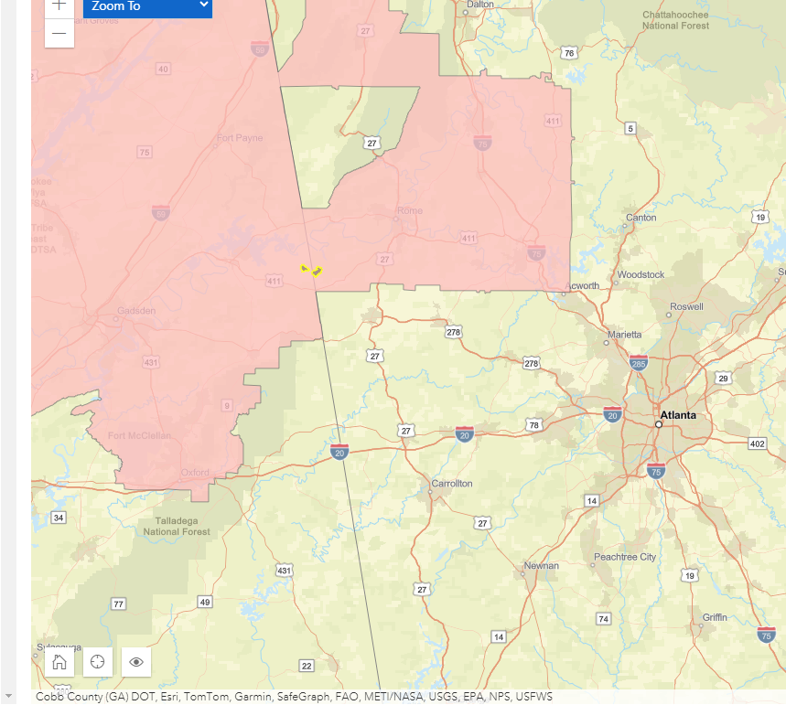
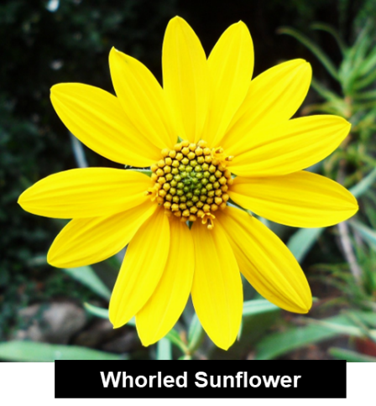

New Liberty Ultra Label - ESA Restrictions
3 points
avoidance area
Runoff
10 ft
Drift grd
BLT

Slide 27

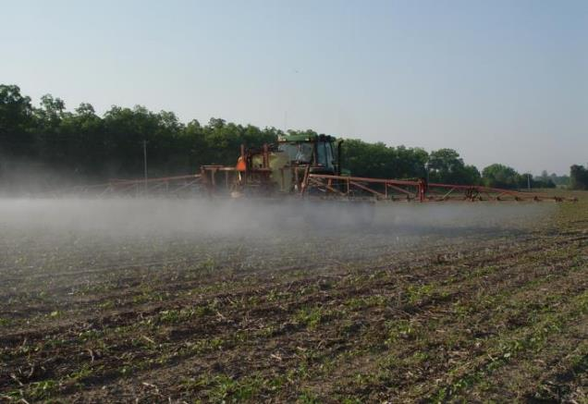
Extension Approach To Overcome Herbicide Strategy!
#1
Objective 1: Get you to 9 points for all fields to avoid runoff mitigations.
Objective 2: Help you make sure you can take 230 buffer down to near 0.
Objective 3: You help us understand any barriers to meet these objectives.
#2
Particle drift
Keep in mind, we are hopeful most products require 6 points or less but there will be important exceptions!

Slide 28
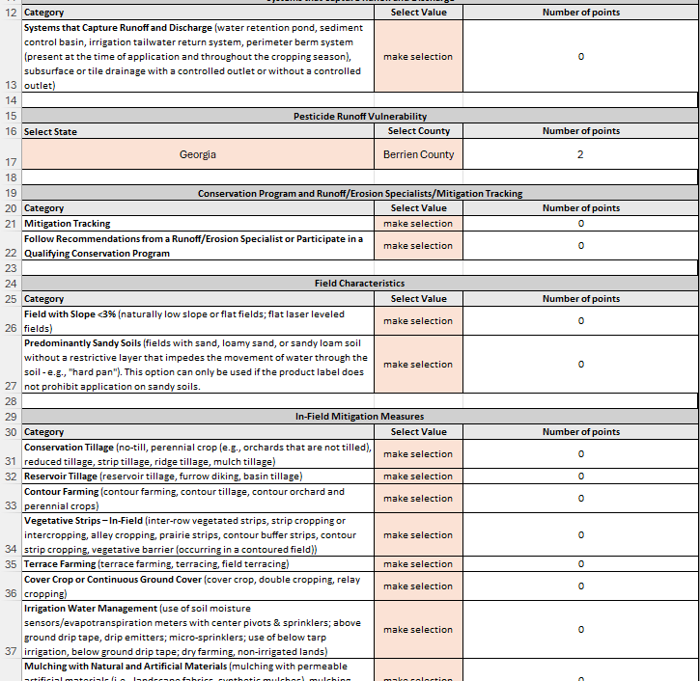
Information Available To Help = EPA Resource Toolbox?
Mitigation Menu
Mitigation Calculator Guide
Calculator is Key
Advisor……KEY
Farmer…not so much
EPA’s RUNOFF POINTS CALCULATOR
https://www.epa.gov/pesticides/mitigation-menu
https://www.epa.gov/endangered-species/pesticides-and-endangered-species-educational-resources-toolbox

Slide 29
Agronomic Crop in Georgia
Mitigation | Points
Mitigation relief points
Field with < 3% slope
Sand, loamy sand or sandy loam (no hard pan)
Cover crops (no tillage)
Strip-till production
Non-irrigated lands
Incorporation (center pivot activation)
Grass waterway
Terraces
Field border of vegetation (20 ft = 1 pt, etc…)
Mitigation tracking

Slide 30
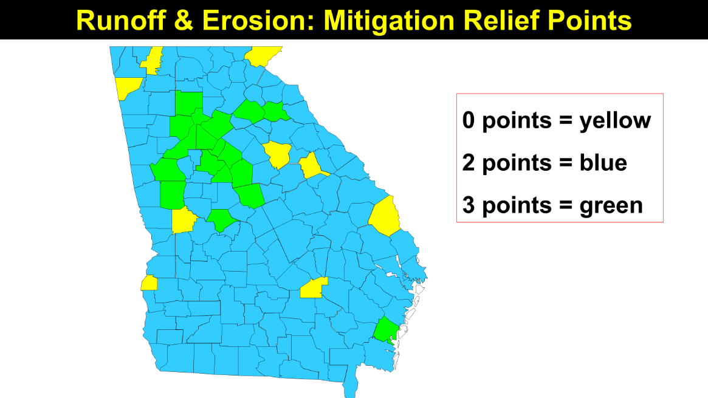
Agronomic Crop in Georgia
Mitigation | Points
Mitigation relief points | 2

Slide 31
Agronomic Crop in Georgia
Mitigation | Points
Mitigation relief points | 2
Field with < 3% slope | 2
Field Slope < 3%
Land leveling, laser leveling, land smoothing are approved
2 points

Slide 32
Agronomic Crop in Georgia
Mitigation | Points
Mitigation relief points | 2
Field with < 3% slope | 2
Sand, loamy sand or sandy loam (no hard pan) | 2
Predominately Sandy Soil
50% sand, loamy sand, or sandy loam without restrictive layer that impedes movement of water into the soil
2 points

Slide 33
Agronomic Crop in Georgia
Mitigation | Points
Mitigation relief points | 2
Field with < 3% slope | 2
Sand, loamy sand or sandy loam (no hard pan) | 2
Cover crops (no tillage) | 3
Cover Crop Options – Points
Tilled cover: terminated using tillage. POINTS = 1
Short duration cover: planted in fall but no active growth in spring or planted in spring. POINTS = 2
Long duration cover: planted in fall growing into spring, vegetation on field year around. POINTS = 3

Slide 34
Agronomic Crop in Georgia
Mitigation | Points
Mitigation relief points | 2
Field with < 3% slope | 2
Sand, loamy sand or sandy loam (no hard pan) | 2
Cover crops | 3
Strip-till production | 2
Strip-till, Mulch Till, No Till: Must have 30% residue on surface
Strip Till: Soil undisturbed except for strips up to 1/3rd the row width. Disc openers, coulters, row cleaners, in-row chisel can be used; cultivation emergency weed control. POINTS = 2
Mulch Till: 100% of soil surface disturbed but uniform layer or residue. POINTS = 2
No Till: Disc openers, coulters, and row cleaners but no tillage. POINTS = 3

Slide 35
Agronomic Crop in Georgia
Mitigation | Points
Mitigation relief points | 2
Field with < 3% slope | 2
Sand, loamy sand or sandy loam (no hard pan) | 2
Cover crops | 3
Strip-till production | 2
Non-irrigated lands | 0
Incorporation (center pivot or tillage) | 1
Non-Irrigated Lands and Incorporation
Non-Irrigated Lands: must not be irrigation on the land during year. POINTS = 3
Incorporation: For products not requiring incorporation, irrigation within 24 hrs or tillage moving herbicide to depth of 1” before first runoff. POINTS = 1

Slide 36
Agronomic Crop in Georgia
Mitigation | Points
Mitigation relief points | 2
Field with < 3% slope | 2
Sand, loamy sand or sandy loam (no hard pan) | 2
Cover crops (no tillage) | 3
Strip-till production | 2
Non-irrigated lands | 0
Incorporation (center pivot activation) | 1
Grass waterway | 0
Terrace | 0
Grass Waterway & Terraces
Waterway: Downslope of application area; regularly maintained, vegetative cover, and outlet stability; inspected regularly; no width defined. 2 Points
Terraces: Stair-stepping technique creating a flat crop areas having a 3% slope or less. 2 Points

Slide 37
Agronomic Crop in Georgia
Mitigation | Points
Mitigation relief points
Field with < 3% slope
Sand, loamy sand or sandy loam (no hard pan)
Cover crops (no tillage)
Strip-till production
Non-irrigated lands
Incorporation (center pivot activation)
Grass waterway
Terraces
Field border of vegetation | 0
Mitigation tracking | 1
Field Border and Mitigation Tracking
Field Border: strip of permanent vegetation established at the edge of the field (downslope). Maintain to eliminate or significantly reduce flow.
20-30 feet: 1 Point
30-60 feet: 2 Points
>60 feet: 3 Points
Mitigation tracking: Document your mitigations: 1 Point

Slide 38
Agronomic Crop in Georgia
Mitigation | Points
Mitigation relief points | 2
Field with < 3% slope | 2
Sand, loamy sand or sandy loam (no hard pan) | 2
Cover crops | 3
Strip-till production | 2
Non-irrigated lands | 0
Incorporation (center pivot or tillage) | 1
Grass waterway | 0
Terraces | 0
Field border of vegetation | 0
Mitigation tracking | 1
Do you have at least 9 points?

Slide 39
Other Options if Needed – Agronomic Crop
Exempt – managed areas 1000 foot down gradient
Expert (1 point) or conservation program (2 points)
3. Water sensors with center pivot = 2 points
4. Mitigation measures from multiple categories = 1 pt
Trying to avoid
Rate of product applied (annual max)
Percent of field treated (new technologies)
Trying even harder to avoid

Slide 40
Culpepper Farms: Fields 1- 36
Mitigation | Points
Mitigation relief points – Northampton County | 2
Field with less 3% slope | 2
Cover crops | 3
Strip till | 2
Dry Farming | 3
Grass waterways | 2
Multiple categories of mitigation | 1
Mitigation tracking | 1
16

Slide 41
Culpepper Farms: Fields 37-40
Mitigation | Points
Mitigation relief points – Northampton County | 2
Field with less 3% slope | 2
Cover crops | 3
Strip till | 2
Dry farming | 3
Mitigation tracking | 1
13
A few fields do not have grass waterways so when I take that away I lose multiple category mitigation as well

Slide 42
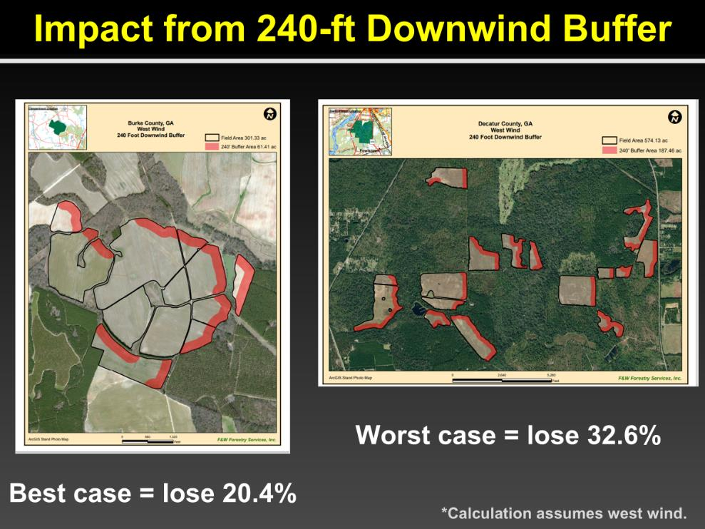

Impact From In-Field Drift Buffers*
EPA DETERMINED WORST CASE FOR GROUND RIG WILL BE 230 FEET DOWNWIND
Calculations are BEFORE WE GET CREATIVE using the flexibility offered by the final herbicide strategy
* As interpreted in the Draft Herbicide Strategy

Slide 43
Spray Drift Ground Application– (0 to 230 feet)
Mitigation Measures | % Reduction
Low boom 24 inch above target, coarse drops | 75%
High boom, coarse drops | 65%
Low boom, fine to medium | 40%
Low boom, coarse drops = 75% or 58 feet for worst case

Slide 44
Boom Height and Spray Droplet Size Impacts Pesticide Drift Distance (feet) to COTTON
Medium droplet
Ultra Coarse droplet
188 a
85 b
68 b
36 c
48”
24”
48”
24”
Boom Height
Boom Height

Slide 45
Spray Drift Ground Application– (0 to 230 feet)
Mitigation Measures | % Reduction
Low boom, coarse drops | 75%
Relative humidity > 60% | 10%
DRA as influenced by droplet | 15-30%
Low boom, coarse drops, RH = 75 + 15 + 10 = 100% or 0 feet

Slide 46
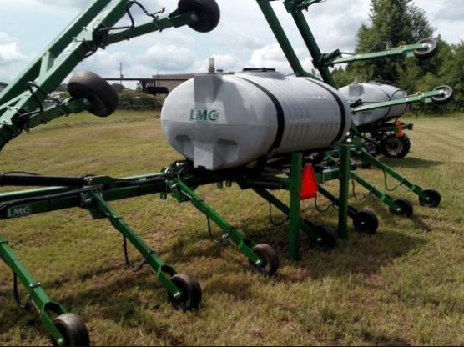
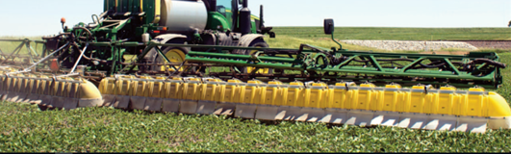
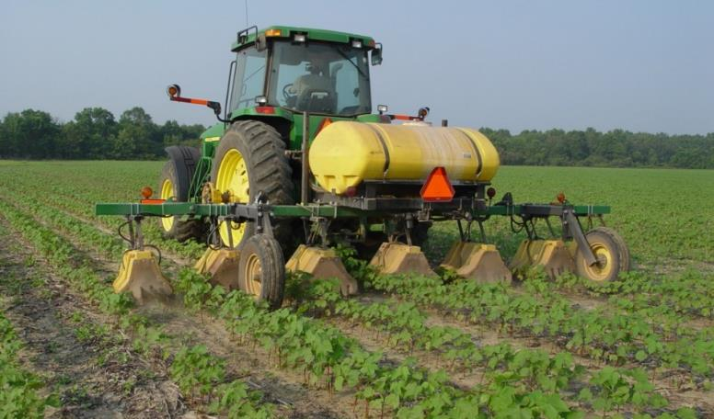
Additional Methods to Reduce Buffer
Broadcast Hooded: 50%
Downwind Measures | % Reduction
Rate of product (single ap) | % below max
Windbreak – 4 foot wide, height of boom | 50%
Windbreak – 8 foot wide, 2X boom height | 75%
Forest/shrubland > 60 ft, 2X boom height | 100%
Layby Rig: 50%
Hooded: 75%

Slide 47
Managed Areas Adjacent To Treated Field Downwind Can Represent Spray Drift Buffers
Approved Out of Field Buffers Downwind - Relevant to Georgia*
Ag fields
Roads, grassy areas, bareground
Field borders, hedgerows, CRP
On-farm contained irrigation water sources (irrigation ponds)
*More options are available through herbicide strategy!

Slide 48



Who is Responsible for Ensuring Compliance
Department of Ag is responsible
Occasional random inspection is possible
Most likely when you get called in for a drift complaint

Slide 49
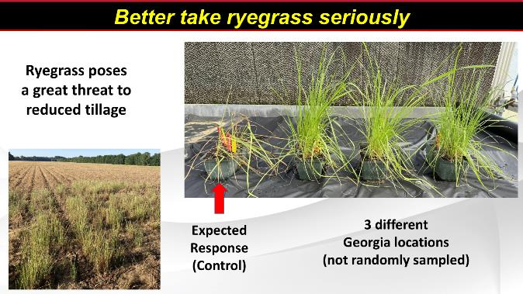
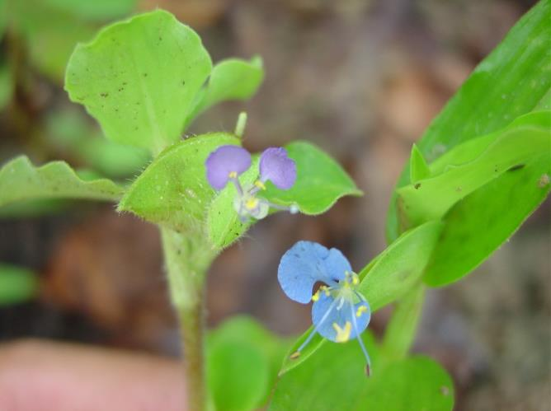
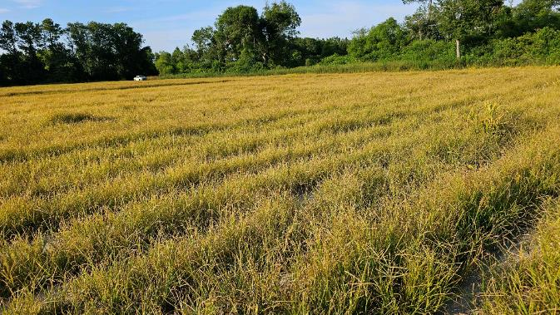
Other Critical Topics – Get The Handout
HANDOUTS:
COTTON
ESA
Wheat
Cole Crops
Greens
Squash
Sweet Potato
Watermelon
Tropical spiderwort
Goosegrass infests GA cotton

Slide 50
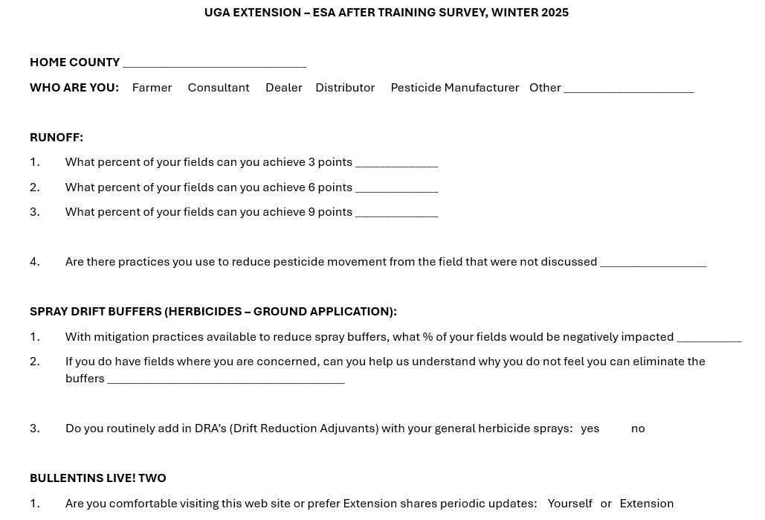
Please Fill Out Survey

Slide 51







Science, Cooperation, & Communication
Farmers
Industry Partners

